Slide 1


Robotics Workshop Week 5 Recap
Notes:
Hello everyone and welcome to the 5th robotics workshop.
In today’s workshop we wont be going through a new worksheet, but instead give you a chance to consolidate what you’ve learnt so far. This may include doing any workshops you’ve missed, couldn’t finish or fully understand; to combining concepts from different worksheets to make something new.
This Is to really make sure you understand the basics before we move onto more advanced topics next week and beyond, AND eventually making your own projects from scratch.

Slide 2
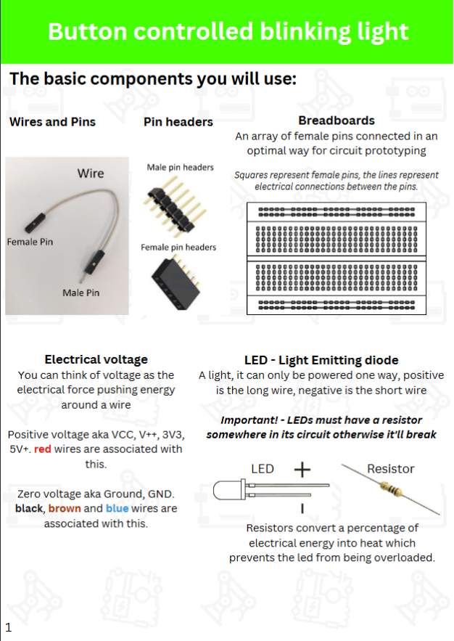
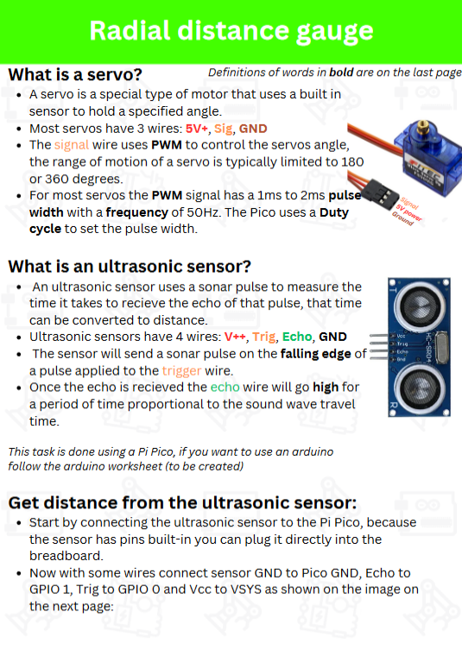
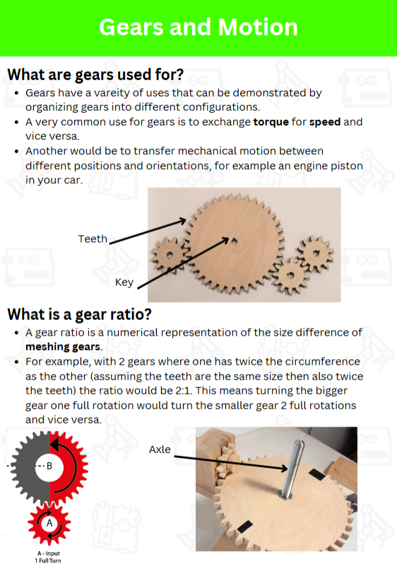
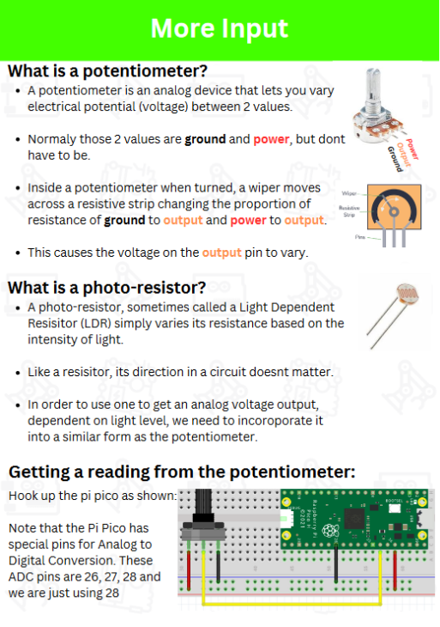
Previous 4 worksheets
Week 1
Intro to Electronics,
Microcontrollers, LED’s,
Buttons
Week 2
Distance Sensor
and Servo
Week 3
Intro to gears
and mechanics
Week 4
Potentiometers, LDR’s,
Many LED’s
Notes:
In the last 4 weeks we have covered the basics of electrical circuits; microcontrollers and how to program them; various input and output devices; gears and mechanical motion; etc…
Please pick and choose one or multiple worksheets to complete/combine or try something completely new.
We also have new boxes for each group kit, so we can store all gear parts and larger devices instead of handing them out separately, when you finish up if you could put the stuff in a new box and throw in a few gears as well, that would be great.
Lets get started.

